Slide 1
Chapter 1 Lesson 1
Machine Learning
Grew out of work in AI
New capability for computers
Examples:
Database mining
Large datasets from growth of automation/web.
E.g., Web click data, medical records, biology, engineering
Applications can’t program by hand.
E.g., Autonomous helicopter handwriting recognition, most of Natural Language Processing(NLP),Computer Vision.
Self-customizing programs
E.g., Amazon, Netflix product recommendations
- Understanding human learning(brain, real AI)

Slide 2
Chapter 1 Lesson 2
What is machine learning ?

Slide 3
Chapter 1 Lesson 2
Machine Learning definition
Arthur Samuel (1959). Machine Learning: Field of study that gives computers the ability to learn without being explicitly programmed.
Tom Mitchell (1998) Well-posed Learning Problem:
A computer program is said to learn from experience
E with respect to some task T and some performance
measure P, if its performance on T as measured by P,
improves with experience E.

Slide 4
Chapter 1 Lesson 2
Machine learning algorithms:
Supervised learning
Unsupervised learning
Others: Reinforcement learning, recommender systems.
Also talk about: Practical advice for applying learning algorithms

Slide 5
Chapter 1 Lesson 3
Introduction
Supervised
Learning

Slide 6
Chapter 1 Lesson 3
- Supervised Learning
“right answers” given
- Regression: Predict continuous valued output(price)
- Classification
Discrete valued output(0 or 1)
0, 1, 2, 3
Benign type1 cancel …
Age\Tumor Size
More futures can be used
Clump Thickness
Uniformity of Cell Size
Uniformity of Cell Shape …
Support Vector Machine Algorithm can support infinite features.

Slide 7
Chapter 1 Lesson 4
Introduction
Unsupervised
Learning

Slide 8
Chapter 1 Lesson 4
Clustering Algorithm
Google News…
Cocktail party problem
[W,s,v] = svd((repmat(sum(x.x*,1),size(x,1),1).*x)*x’)

Slide 9
Chapter 1 Lesson 6 (No useful knowledge in Lesson 5)
Linear regression with one variable
Model representation

Slide 10
Chapter 1 Lesson 6
Housing Prices(Portland,OR)
Supervised Learning
Given the “right answer” for each example in the data.
Regression Problem
Predict real-value output
Classification
Predict discrete-valued outputs

Slide 11
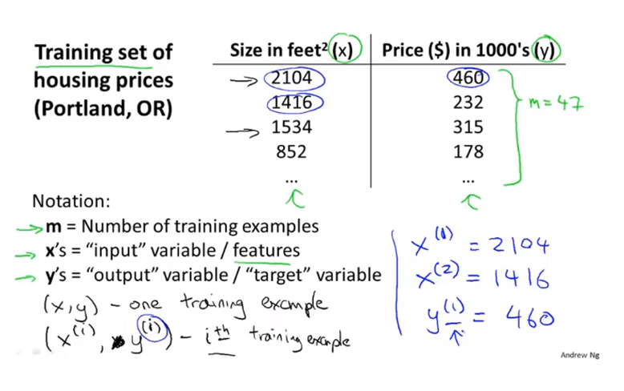
Chapter 1 Lesson 6

Slide 12
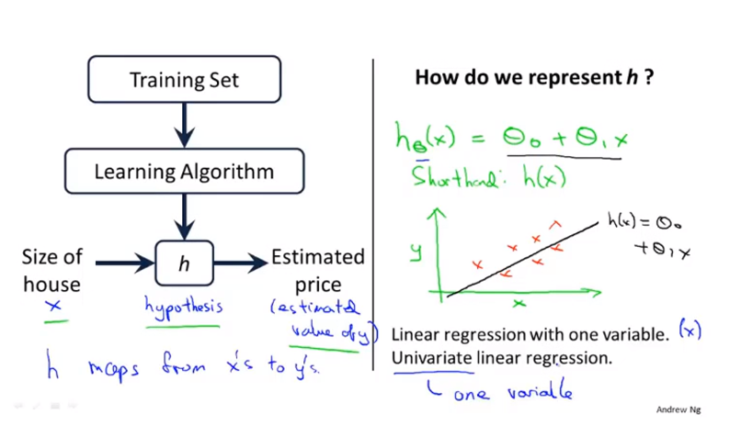
Chapter 1 Lesson 6

Slide 13
Chapter 2 Lesson 7
Linear regression with one variable
Cost function

Slide 14
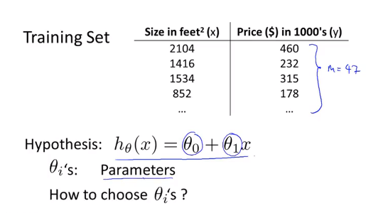
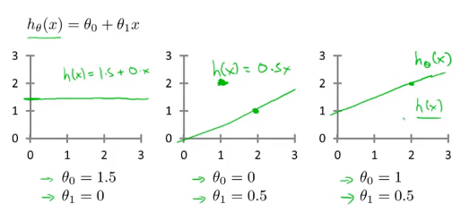
Chapter 2 Lesson 7

Slide 15
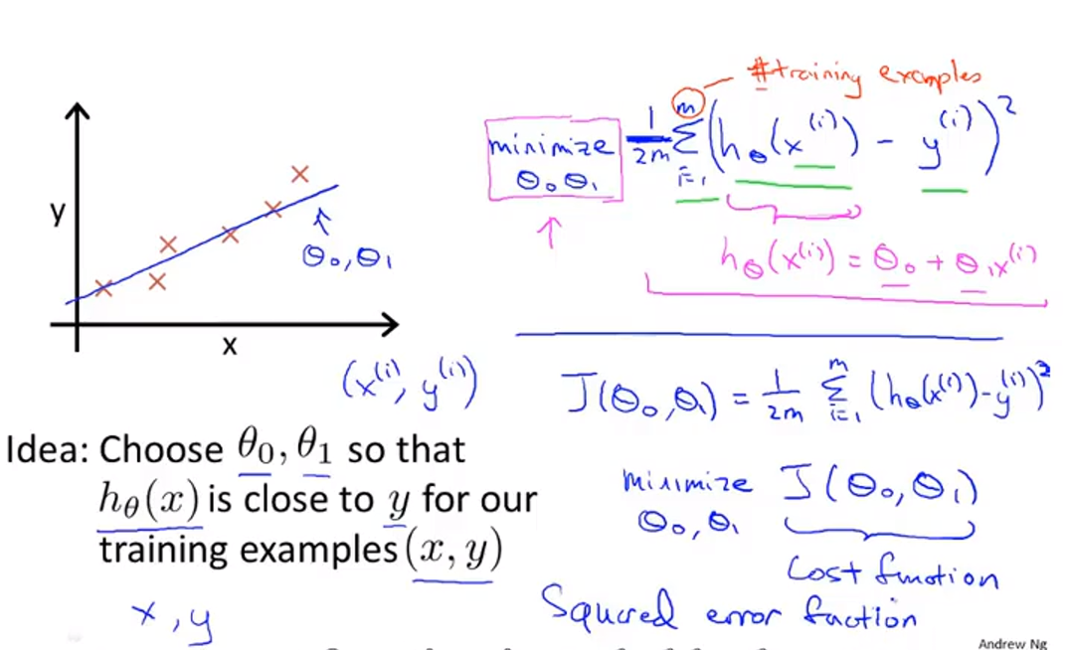
Chapter 2 Lesson 7

Slide 16
Chapter 2 Lesson 8
Linear regression with one variable
Cost function Ⅰ

Slide 17
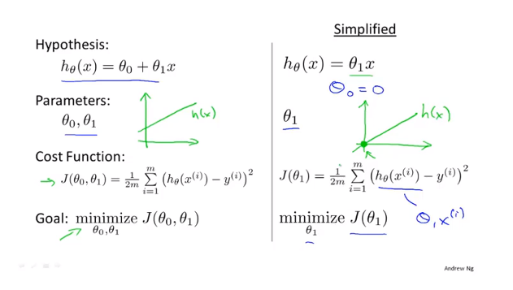
Chapter 2 Lesson 8

Slide 18
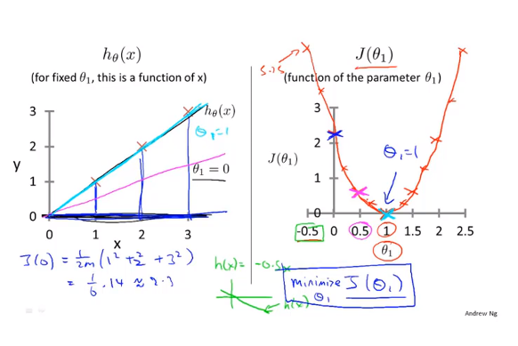
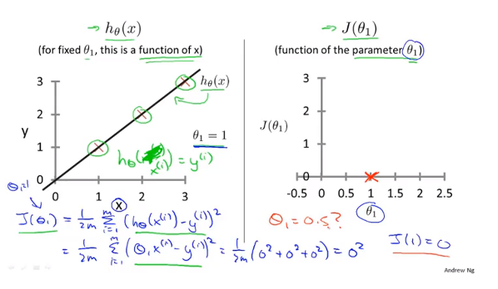
Chapter 2 Lesson 8

Slide 19
Chapter 2 Lesson 9
Linear regression with one variable
Cost function Ⅱ

Slide 20
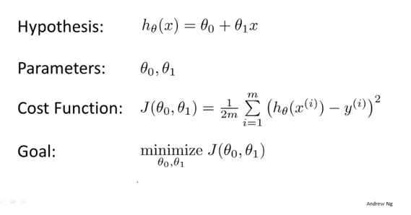
Chapter 2 Lesson 9

Slide 21
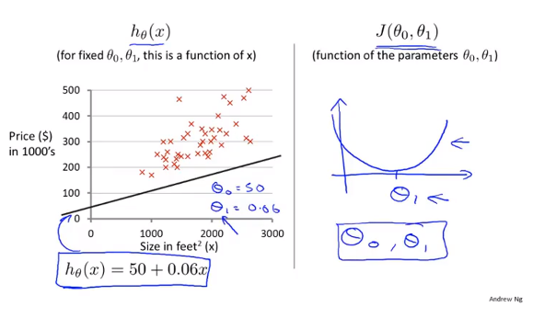
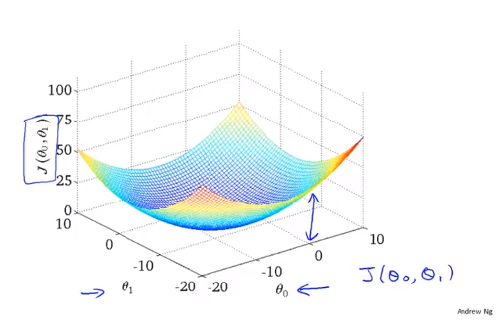
Chapter 2 Lesson 9

Slide 22
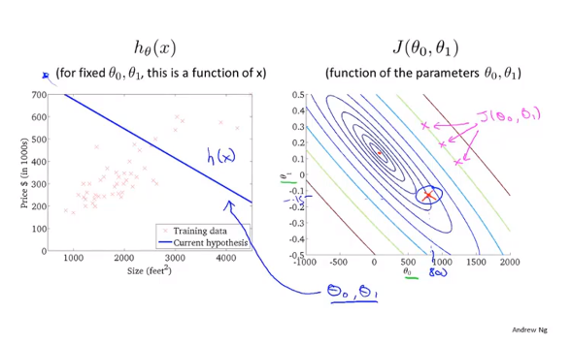
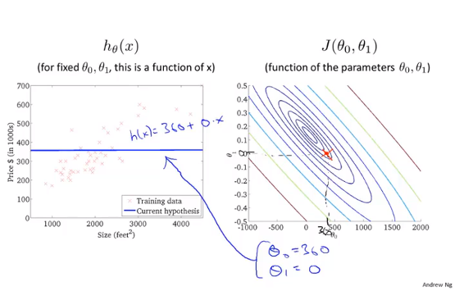
Chapter 2 Lesson 9

Slide 23
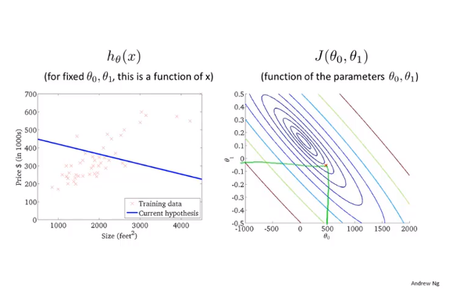
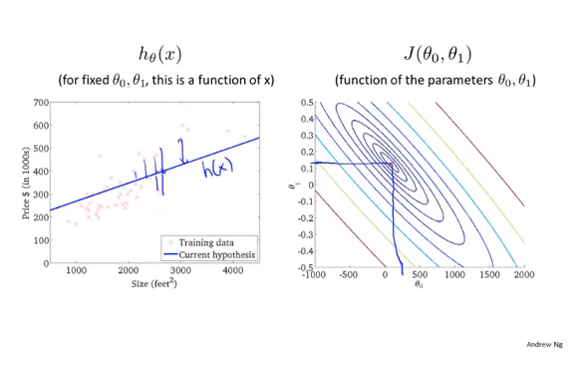
Chapter 2 Lesson 9

Slide 24
Chapter 2 Lesson 10
Linear regression with one variable
Gradient descent

Slide 25
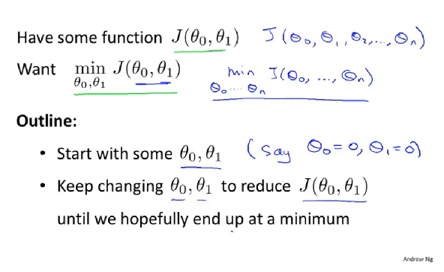
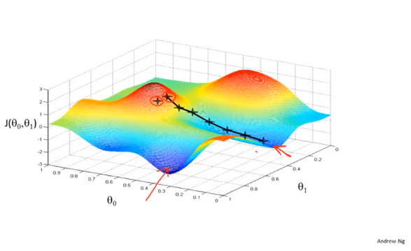
Chapter 2 Lesson 10

Slide 26
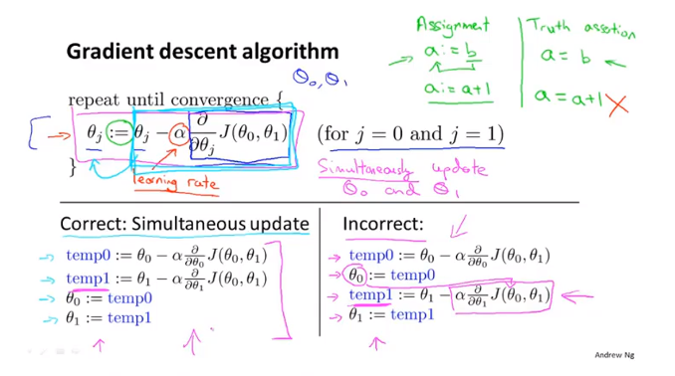
Chapter 2 Lesson 10

Slide 27
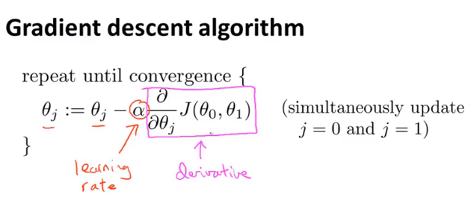
Chapter 2 Lesson 11

Slide 28
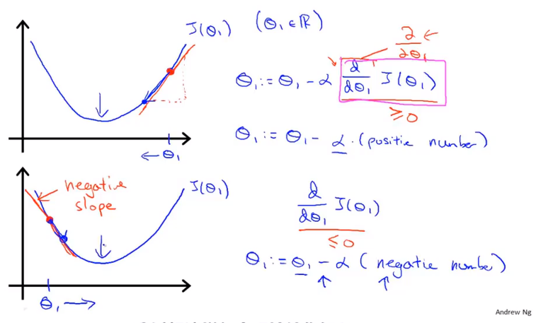
Chapter 2 Lesson 11

Slide 29
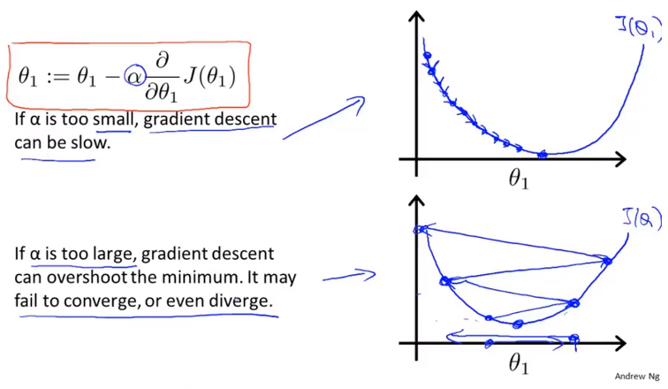
Chapter 2 Lesson 11

Slide 30
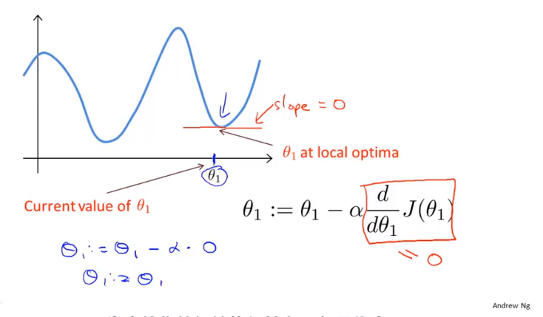
Chapter 2 Lesson 11

Slide 31
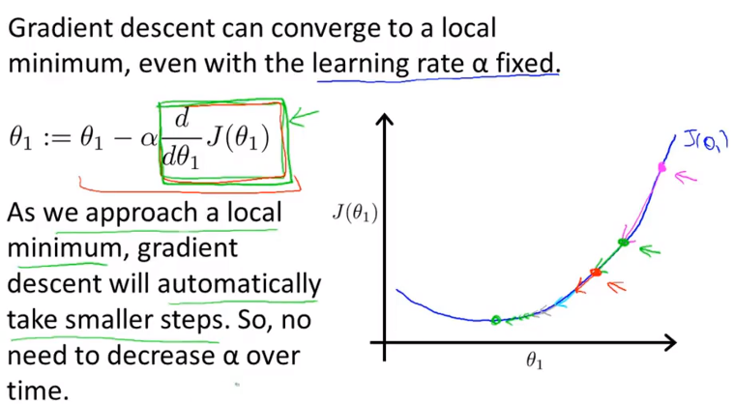
Chapter 2 Lesson 11

Slide 32
Chapter 2 Lesson 12
Linear regression with one variable
Gradient descent for linear regression

Slide 33
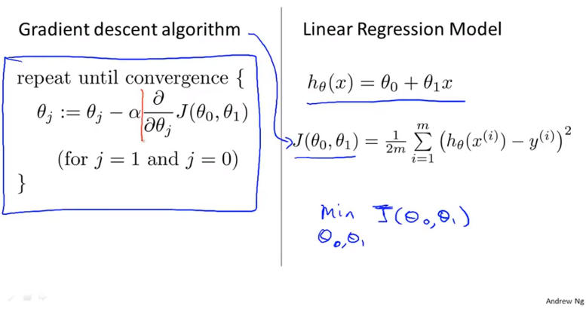
Chapter 2 Lesson 12

Slide 34
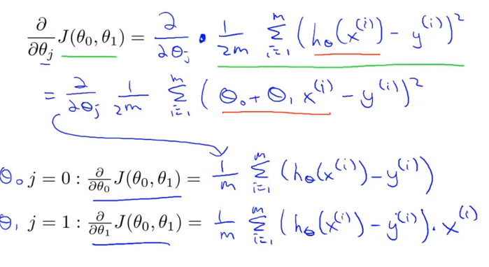
Chapter 2 Lesson 12

Slide 35
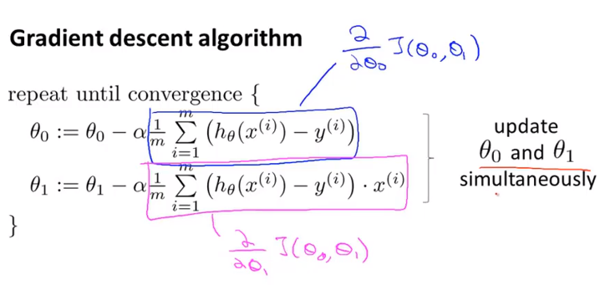
Chapter 2 Lesson 12

Slide 36
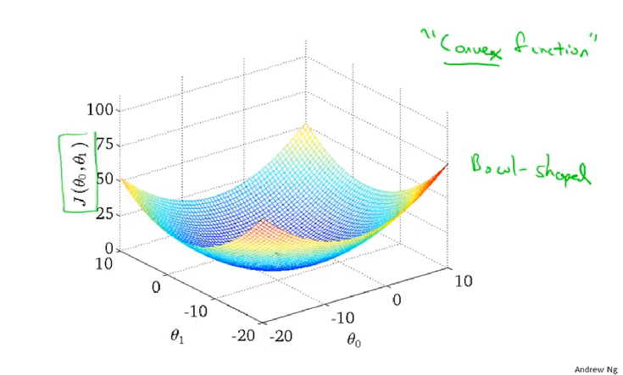
Chapter 2 Lesson 12

Slide 37
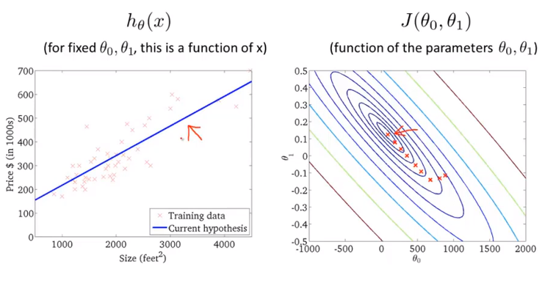
Chapter 2 Lesson 12

Slide 38
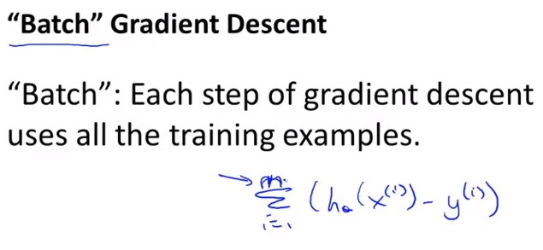
Chapter 2 Lesson 12
Numerically solving for the minimum of the cost function J
Called normal equations methods
Gradient Descent will scale better to lager data sets than NEM

